Slide 1


A presentation on my STUDENT INDUSTRIAL WORK EXPERIENCE SCHEME (SIWES) undertaken at HIIT PLC by Egemonye Jeremiah (DU0383)

Slide 2
HISTORY OF THE ESTABLISHMENT
HiiT Plc is Nigeria’s best Indigenous IT Training Establishment. We have excelled in IT Training/Education, Publishing, IT Consultancy and IT Solutions Development & Services.
Founded 27 years ago, it has consistently exceeded expectations, earning the prestigious title of "Nigeria's Best Indigenous IT Training Establishment." HiiT PLC's success extends beyond training, embracing a diverse portfolio of IT services that empower individuals and businesses.

Slide 3
COMPANY’S ORGANIZATIONAL SRUCTURE
MD/CEO
EXECUTIVE DIRECTORS
Business Manager
Business Manager
Head of Finance
CSA
Customer Service
Instructors
Software Developer
UI Designer

Slide 4

MY WORK DONE AT HIIT
WEB DEVELOPMENT
Static and Dynamic page creation
Development of web apps
Project Management and Proper presentation creation

Slide 5







LANGUAGES AND TOOLS I WORKED WITH

Slide 6
PROJECTS I WORKED ON
So far, over the SIWES program, I was able to build over 15 projects with the languages percentages as follows below:
JavaScript → ~ 45%
CSS → ~ 30%
HTML → ~ 10%
Others → ~ 15%
Some of these projects include:
Age calculator app
Todo application
Tip calculator app
Crowd funding product page
Task scheduler
Real estate site
…and more

Slide 7
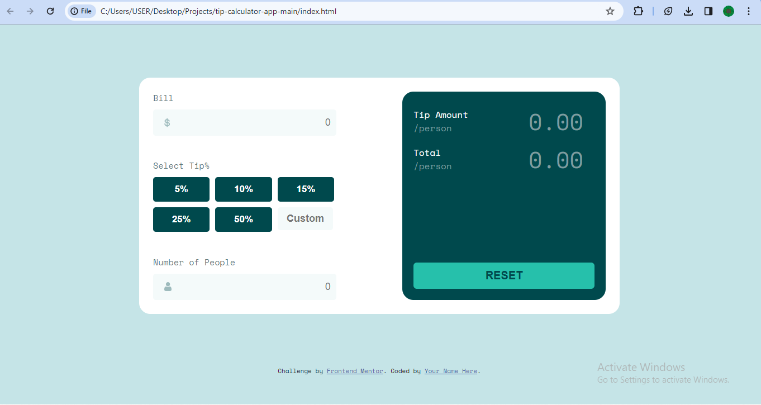
TIP CALCULATOR APP

Slide 8
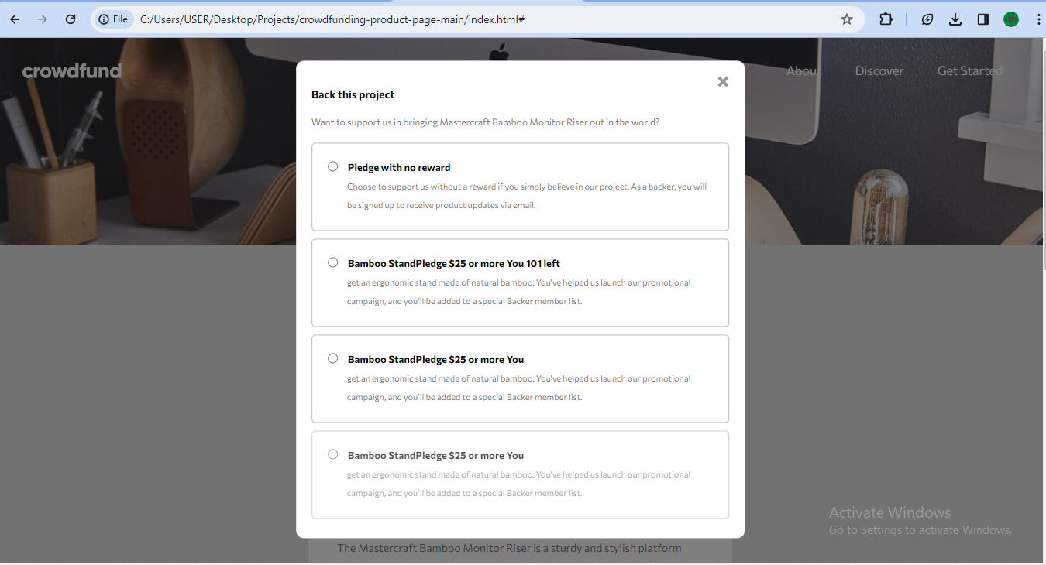
Crowd funding donations site

